Slide 1
SOFTWARE DEVELOPMENT LIFE CYCLE
Prepared By:-
Biswajit Padhi

Slide 2
What is SDLC ? ? ?
SDLC stands for Software Development Life Cycle. SDLC is the process consisting of a series of planned activities to develop or alter the software products.
The SDLC aims to produce a high quality software that meets or exceeds customer expectations, reaches completion within times and cost estimates.

Slide 3
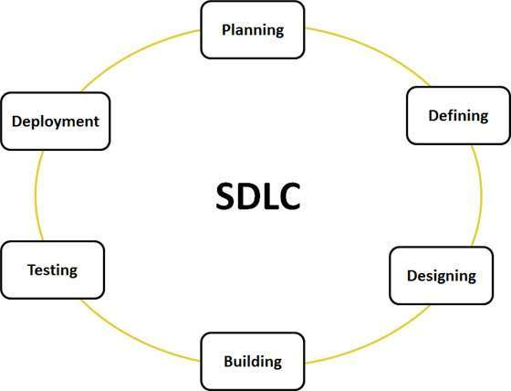

Slide 4
SDLC Models:
Waterfall Model
Iterative Model
Spiral Model
V Model
Big Bang Model
Agile Model
RAD Model

Slide 5
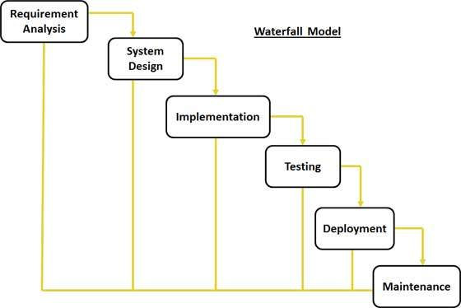
Waterfall Model

Slide 6
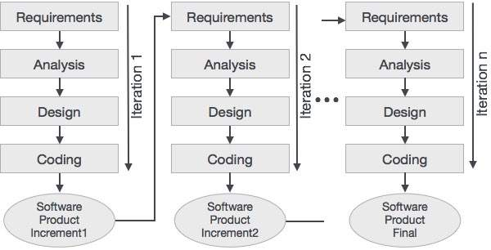
Iterative Incremental Model

Slide 7
AGILE MODEL

Slide 8
Introduction
Agile development is based on iterative incremental development, in which requirements and solutions evolve through team collaboration. It recommends a time-boxed iterative approach, and encourages rapid and flexible response to change.
It is a theoretical framework and does not specify any particular practice that a development team should follow. Scrum is a specific agile process framework that defines the practices required to be followed.

Slide 9
AGILE MANIFESTO:
The Agile Manifesto is as follows:
Individuals and interactions over processes and tools
Working software over comprehensive documentation
Customer collaboration over contract negotiation
Responding to change over following a plan

Slide 10
KEY PRINCIPLES OF AGILE
Satisfaction and Delivery
Welcoming Change
Deliver Frequently
Communication is the Key
Environment and Trust
Face-to-face Communication
Software as Measure of Progress
Sustainable Development
Attention to Details
The Power of Less
Self-organizing Teams

Slide 11
AGILE METHODOLOGIES:
Dynamic System Development Methodology
Scrum
Extreme Programming
Test Driven Development
Lean
Kanban

Slide 12
SCRUM

Slide 13
Introduction:
Scrum is a framework within which people can address complex adaptive problems, while productively and creatively delivering products of the highest possible value.
The Scrum framework consists of Scrum Teams and their associated roles, events, artifacts, and rules. Each component within the framework serves a specific purpose and is essential to Scrum’s success and usage.

Slide 14
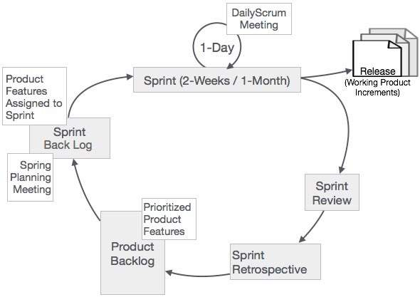

Slide 15
Scrum Roles:
Scrum Master
Product Owner
Scrum Team

Slide 16
Scrum Events:
The Sprint
Sprint Planning
Daily Scrum Meetings
The Sprint Review
The Sprint Retrospective

Slide 17
Scrum Artifacts:
Product Backlog (User Story)
Sprint Backlog
Burn-Down Chart
Increment

Slide 18
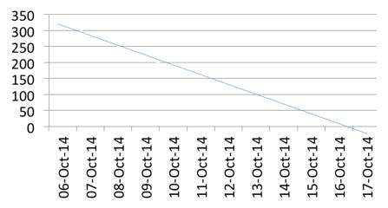
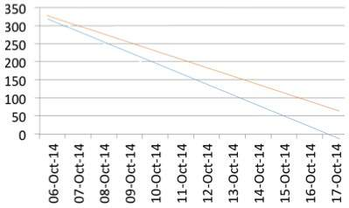
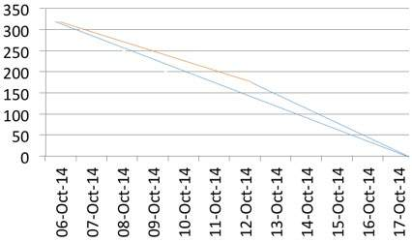

Slide 19
Scrum Tools:
Axosoft | Airgile | Agile Cockpit | Jira (GreenHopper) | Mingle
Scrumwise | Agilo For Scrum | Banana Scrum | Kunagi | OnTime Now
Version One | AgileWrap | Daily-Scrum | Intervals | Pango Scrum
Acunote | Agile Tracking Tool* | Digaboard* | iMeta Agility | Pivotal Tracker
Agile Agenda | Agile Task | EasyBacklog | Ice Scrum* | pmScrum
Agile Bench | Agile Soup | Explain PMT | Hansoft | Prj Planner
Agile Buddy | Agile Manager | Agile Express* | GravityDev | Project Cards
Agile Fant* | Agile Log | Fire Scrum* | Fulcrum* | Quantum Whisper
Quick Scrum | Retrospectiva* | Scrum’d | Scrum Factory* | Scrumpy
Rally Dev | Scrinch* | Scrum Dashboard* | Scrum Edge | Scrum Pad
Redmine Backlogs | Scrum 2 Go | Scrum Desk | Scrum Do | Tweet Scrum
Scrumrf | Scrum Time* | Scrumwise | Select Solution Factory | Tackle*
Urban Turtle | ScrumTool | Scrum Works | Timebox | Tangy Orange Scrum

Slide 20
To Whom Scrum can benefit:
Benefit to customer
Benefit to organization
Benefit to product owner
Benefit to project manager
Benefit to Development team

Slide 21


